Slide 1
Business Process Engineering
Business Process Modeling
Lecture: 05
Instructor: Salman Ahmad

Slide 2
Business Process Engineering

Slide 3
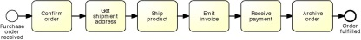
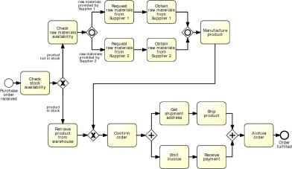
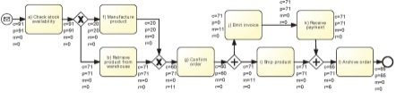
Purposes of process modeling
Communication
Documentation
Analysis (e.g. simulation)

Slide 4
Business Process Model & Notation
OMG Standard (BPMN 2.0)
Both for conceptual and executable models
Supported by many tools

Slide 5
BPMN from a distance
A BPMN process model is a graph consisting of four types of code elements
start
end
activity
events
gateway
Process flow

Slide 6
Let’s do it then
Order to cash
An order-to-cash process is triggered by the receipt of a purchase order from a customer. Upon receipt, the purchase order has to be checked against the stock to determine if the requested item(s) are available. Depending on stock availability the purchase order may be confirmed or rejected.
If the purchase order is confirmed, an invoice is emitted and the goods requested are shipped. The process completes by archiving the order.

Slide 7
Breaking it down
An order-to-cash process is triggered by the receipt of a purchase order from a customer.
Upon receipt, the purchase order has to be checked against the stock to determine if the the requested item(s) are available.
Depending on stock availability the purchase order may be confirmed or rejected.
If the purchase order is confirmed, an invoice is emitted and the goods requested are shipped. The process completes by archiving the order.

Slide 8
Breaking it down
An order-to-cash process is triggered by the receipt of a purchase order from a customer.
Upon receipt, the purchase order has to be checked against the stock to determine if the the requested item(s) are available.

Slide 9
BPMN Model
Notes:
Start event: trigger
End event: process outcome
Split gateway: this is where the control flow is split into two or more branches. In this case the flow is split into two mutually exclusive branches (one taken when items are not in stock, the other when the items are in stock).
Talk about triggers and outcomes: this process has one trigger and two possible outcomes. Without reading the content, I can already see this process can end up in an order being fulfilled (which in this case is a positive outcome) or rejected (negative outcome)
Clearly, for the organization running this process, like a seller or supplier, the goal is to fulfil the order, so that value can be generated for the customer who submitted the order.
It is important to ensure consistency across all our models. One way of doing this is to establish some conventions for labelling events and activities.

Slide 10
Breaking it down
An order-to-cash process is triggered by the receipt of a purchase order from a customer.
Upon receipt, the purchase order has to be checked against the stock to determine if the the requested item(s) are available.
Depending on stock availability the purchase order may be confirmed or rejected.
If the purchase order is confirmed, an invoice is emitted and the goods requested are shipped. The process completes by archiving the order.

Slide 11
BPMN Model
end event
activity
split gateway
end event
start event
Naming conventions
Event: noun + past-participle verb (e.g. insurance claim lodged)
Activity: verb + noun (e.g. assess credit risk)
Notes:
Start event: trigger
End event: process outcome
Split gateway: this is where the control flow is split into two or more branches. In this case the flow is split into two mutually exclusive branches (one taken when items are not in stock, the other when the items are in stock).
Talk about triggers and outcomes: this process has one trigger and two possible outcomes. Without reading the content, I can already see this process can end up in an order being fulfilled (which in this case is a positive outcome) or rejected (negative outcome)
Clearly, for the organization running this process, like a seller or supplier, the goal is to fulfil the order, so that value can be generated for the customer who submitted the order.
It is important to ensure consistency across all our models. One way of doing this is to establish some conventions for labelling events and activities.

Slide 12
Execution of a process model The “token game”
Order #1
Order #2
Order #3
Notes:
One important notion we need to understand when creating process models is the difference between a process model and its process instances, or in other words, the difference between design-time and run-time. In order to understand this difference, we need to know more about start and end events.

Slide 13
More on events
A start event triggers a new process instance by generating a token that traverses the sequence flow (“tokens source”)
An end event signals that a process instance has
completed with a given outcome by consuming
a token (“tokens sink”)
start
event
end
event

Slide 14
Order-to-cash example revisited…
If the purchase order is confirmed, an invoice is emitted and the goods requested are shipped (in any order). The process completes by archiving the order. […]
Notes:
Clearly, we need to archive the order once both the emission of the invoice and the shipment of the goods have been done, but there’s nothing preventing us from emitting the invoice necessarily BEFORE shipping the goods. In other words, we are not concerned about the specific order in which these two activities can take place, so long as they are BOTH completed. I can first emit the invoice or ship the goods. Or event these two activities could start at the same time. Thus, we need to use gateways to model this condition.

Slide 15
First try
split
split
join
Notes:
What’s the problem with this solution?

Slide 16
A little more on gateways: XOR Gateway
An XOR Gateway captures decision points (XOR-split) and points where alternative flows are merged (XOR-join)
XOR-split ➔ takes one outgoing branch
XOR-join ➔ proceeds when one incoming branch has completed
Notes:
The term “Gateway” implies that there is a gating mechanism that either allows or disallows passage of tokens through the Gateway. As Tokens arrive at a Gateway, they can be split apart on output or merged together on input, as the Gateway mechanisms are invoked.
Decision points, where the flow is split between two or more alternatives,

Slide 17
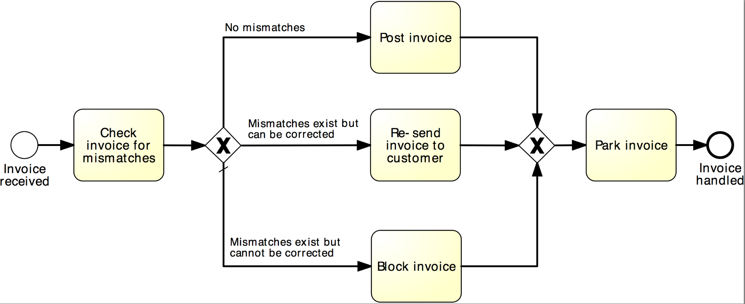
Example: XOR Gateway
Notes:
A default flow is the default branch to be chosen from an (X)OR-split if all other conditions evaluate to false

Slide 18
A little more on gateways: AND Gateway
An AND Gateway provides a mechanism to create and synchronize “parallel” flows.
AND-split ➔ takes all outgoing branches
AND-join ➔ proceeds when all incoming branches have completed
Notes:
By “parallel” we intend flows which can proceed independently of each other

Slide 19
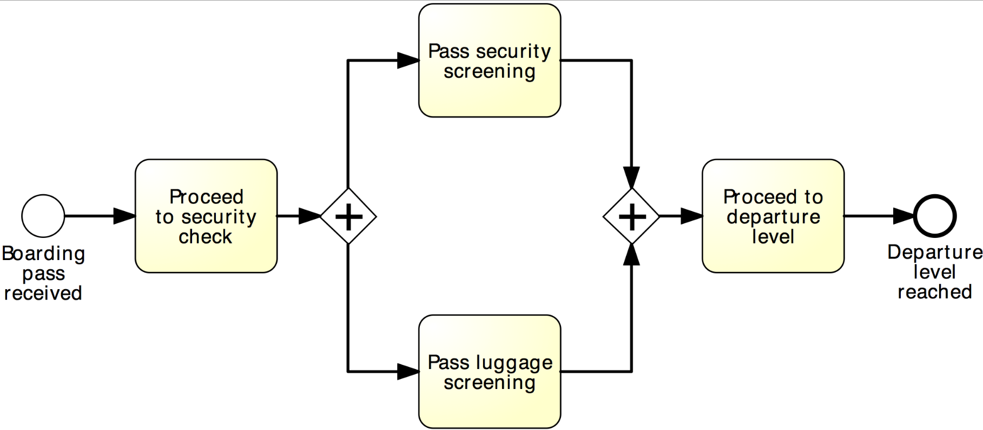
Example: AND Gateway
Airport security check
Notes:
Let’s take, as an example, the security check at an airport. Depending on the layout of the airport, on its passengers traffic at the moment we approach the security check, we may first pass through the security screening and then our luggage will pass through screening, or, for example, luggage screening may start first, and while this is being done, we quickly pass through security screening (as most often happens). However, in order to proceed to the departure level, we first have to pass both screenings: security and luggage

Slide 20
Revised order-to-cash process model
XOR-split
AND-split
AND-join
Notes:
So, coming back to our example, in order to disambiguate these gateways, and assigning a proper behavior to our model, we need to use…

Slide 21
Between XOR and AND
Order distribution process:
A company has two warehouses that store different products: Amsterdam and Hamburg. When an order is received, it is distributed across these warehouses: if some of the relevant products are maintained in Amsterdam, a sub-order is sent there; likewise, if some relevant products are maintained in Hamburg, a sub-order is sent there. Afterwards, the order is registered and the process completes.
Notes:
Sometimes, the number of branches to be taken varies from one instance to another:

Slide 22
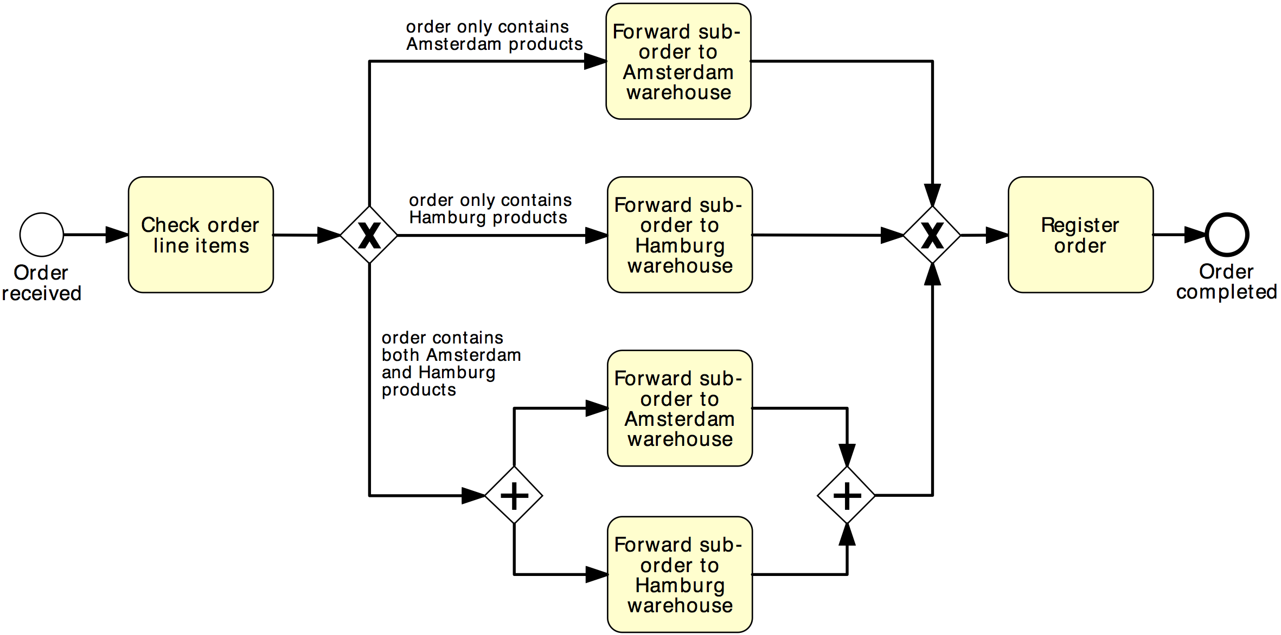
Solution 1
Order distribution process
XOR-split
XOR-join
AND-split
AND-join

Slide 23
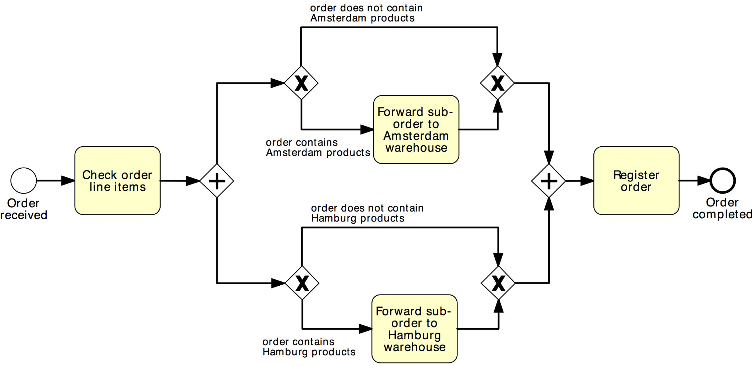
Solution 2
Order distribution process
AND-split
AND-join
XOR-split
XOR-join

Slide 24
OR Gateway
An OR Gateway provides a mechanism to create and synchronize n out of m parallel flows.
OR-split ➔ takes one or more branches depending on conditions
OR-join ➔ proceeds when all active incoming branches have completed
Notes:
By “parallel” we intend flows which can proceed independently of each other
For OR-join make difference with AND-join: “active”

Slide 25
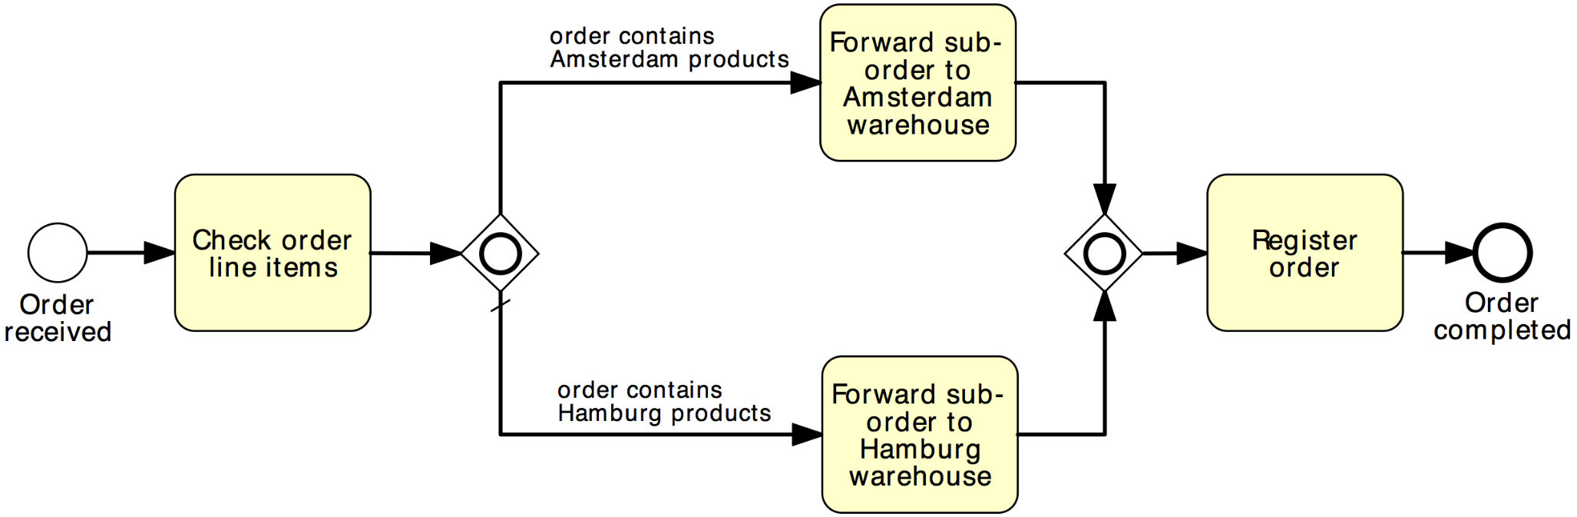
Solution using OR Gateway
Order distribution process
OR-split
OR-join
Notes:
Similar to the XOR-split, the OR-split can be equipped with a default flow which is taken if the conditions on all other branches are false

Slide 26
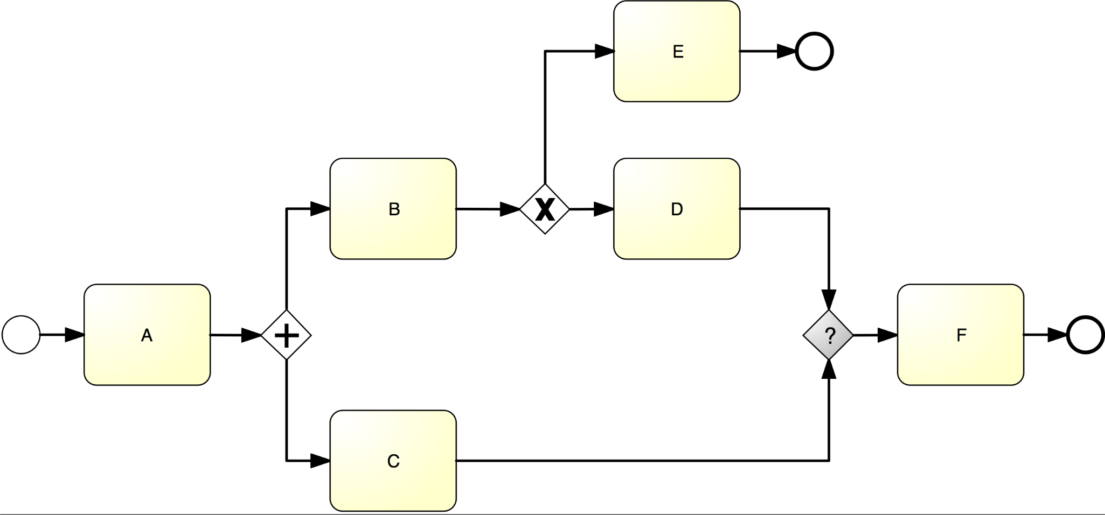
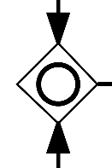
What join type do we need here?

Slide 27

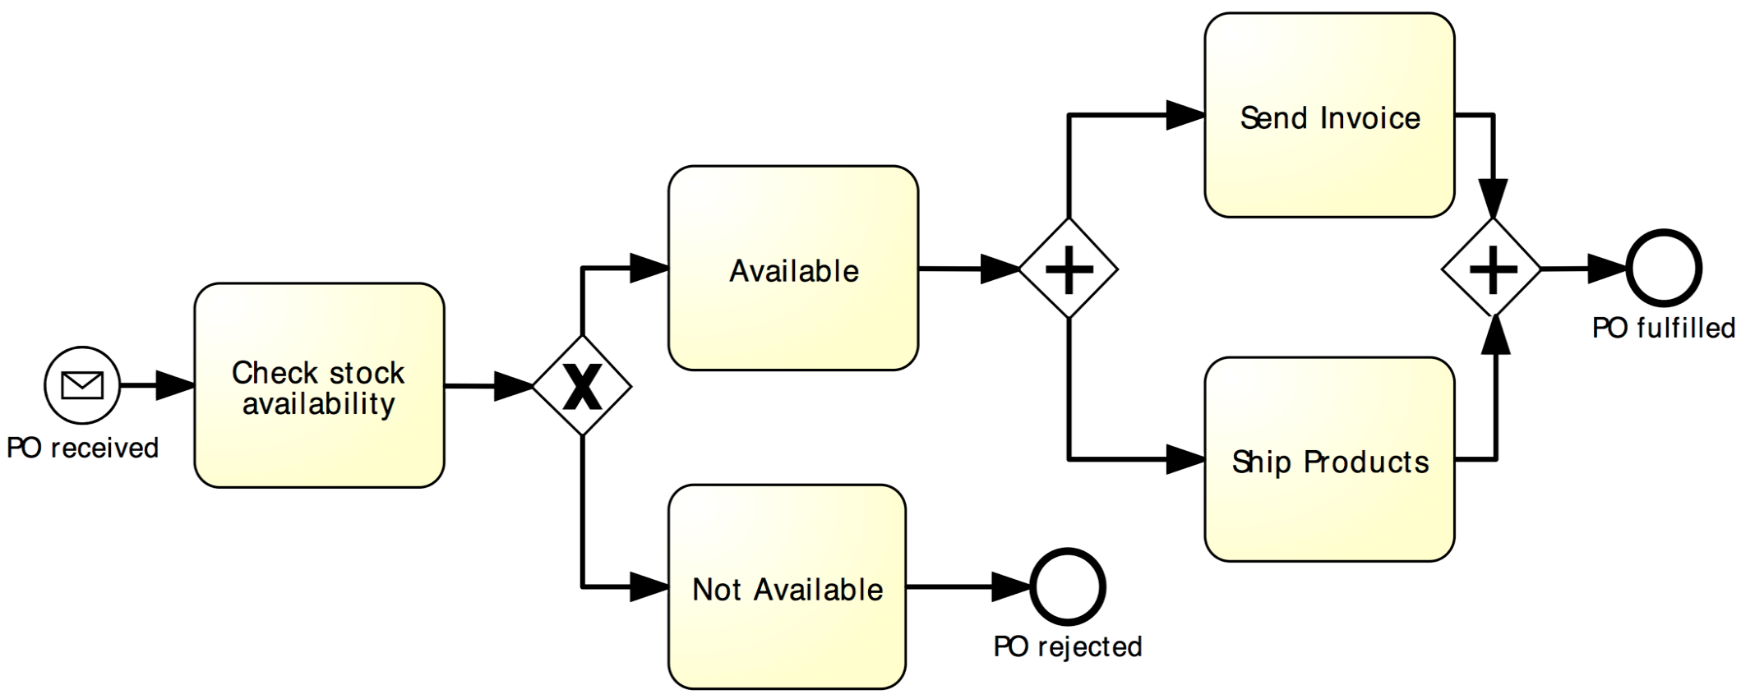
Beware: Beginner’s Mistake
Notes:
It is worth emphasizing here that activities located in two parallel paths do not need to be performed simultaneously. For example, “Send invoice” and “Ship goods” need not occur both at the same time, although due to a cosmic coincidence, they could happen at the same time. Instead, it might happen that first the invoice is sent and later the goods are shipped. Or things may happen in the reverse order.

Slide 28
Guidelines: Naming Conventions
Give a name to every event and task
For tasks: verb followed by business object name and possibly complement
Issue Driver Licence, Renew Licence via Agency
For message events: object + past participle
Invoice received, Claim settled
Avoid generic verbs such as Handle, Record…
Label each XOR-split with a condition
Policy is invalid, Claim is inadmissible

Slide 29
Poll: Which model do you prefer?
Notes:
Release of a software product

Slide 30
One more guideline…
Model in blocks
Pair up each AND-split with an AND-join and each XOR-split with a XOR-join, whenever possible
Exception: sometimes a XOR-split leads to two end events – different outcomes (cf. order management example)

Slide 31
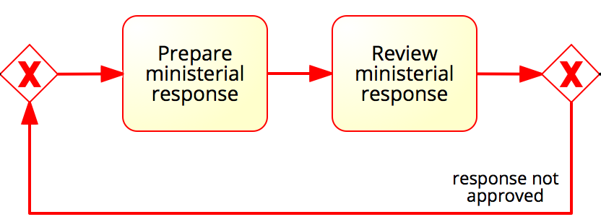
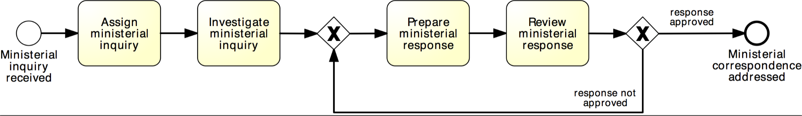
Rework and repetition
Address ministerial correspondence
In the minister’s office, when a ministerial inquiry has been received, it is registered into the system. Then the inquiry is investigated so that a ministerial response can be prepared.
The finalization of a response includes the preparation of the response itself by the cabinet officer and the review of the response by the principal registrar. If the registrar does not approve the response, the latter needs to be prepared again by the cabinet officer for review. The process finishes only once the response has been approved.
XOR-join: entry point
XOR-split: exit point
Notes:
So far we have seen structures that are linear, i.e., each activity is performed at most once. However, sometimes we may require to repeat one or several activities, for instance because of a failed check.
Repetition block, a block between an XOR-join (entry point) and an XOR-split (exit point), where the last activity is a decision activity, that allows us to repeat the block or get out of the block.
A cycle is a flow that goes back to an “earlier” point of the process. It is used to model parts of the process that can be repeated.

Slide 32
Quick Note: Implicit vs. explicit gateways

Slide 33
How this process starts? How it ends?
Notes:
Also point to the two triggers (new mail and new email).

Slide 34
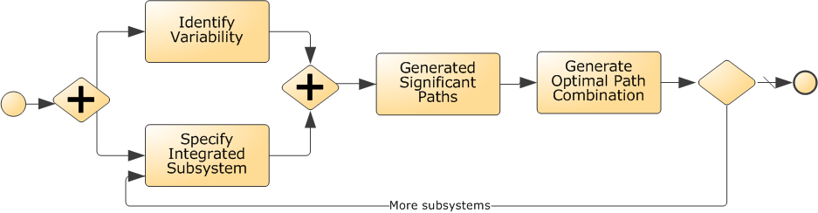
What’s wrong with this model? How to fix it?
X

Slide 35
Process Modelling Viewpoints
Organization
Who?
Lanes &
Pools
What?
Tasks
Events
When?
Flows
Gateways
Which?
Data Objects, Stores
Data / Materials
Notes:
The Functional perspective, indicates What tasks/function are happening in the process?
The Control-flow perspective, indicates when should an activity be performed, that is, in what order should activities and events occur?
The resource perspective (also called organisational perspective) indicates Who performs which activity?
Finally, the data perspective indicate which data are necessary to perform each activity and which data are produced by each activity in the process?

Slide 36
Organizational Elements in BPMN – Pools & Lanes
Pool
Captures a resource class. Generally used to model a business party (e.g. a whole company)
Lane
A resource sub-class within a pool. Generally used to model departments (e.g. shipping, finance), internal roles (e.g. Manager, Associate), software systems (e.g. ERP, CRM)
Notes:
A Pool acts as the container for the Sequence Flow between activities. The Sequence Flow cannot cross the boundaries of a Pool
Lanes can be nested (e.g. an outer set of Lanes for company departments and an inner set for roles within each department)
Complement your BPMN models with organizational charts, role-responsibility matrices, RACI diagrams

Slide 37


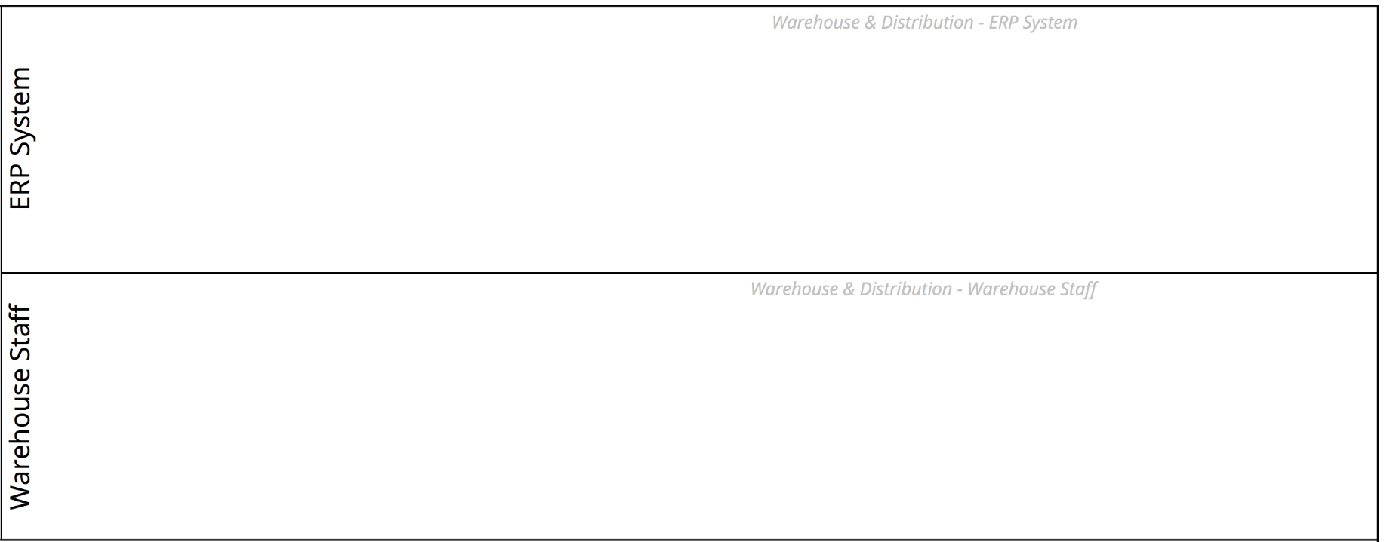
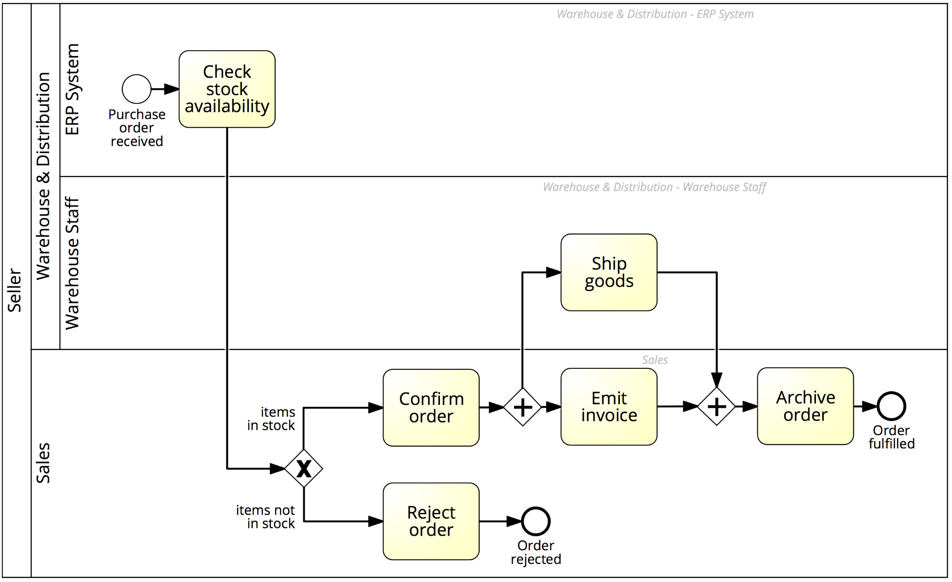
Order-to-cash process with lanes

Slide 38
Message Flow
A Message Flow represents a flow of information between two process parties (Pools)
A Message Flow can connect:
directly to the boundary of a Pool ➔ captures an informative message to/from that party
to a specific activity or event within that Pool ➔ captures a message that triggers a specific activity/event within that party
Notes:
The interaction between Pools, e.g., between two collaborating organizations, is shown through the Message Flow
Depicted by a dashed line with an open arrowhead
Describe send and receive activity and their semantics in terms of data tokens

Slide 39
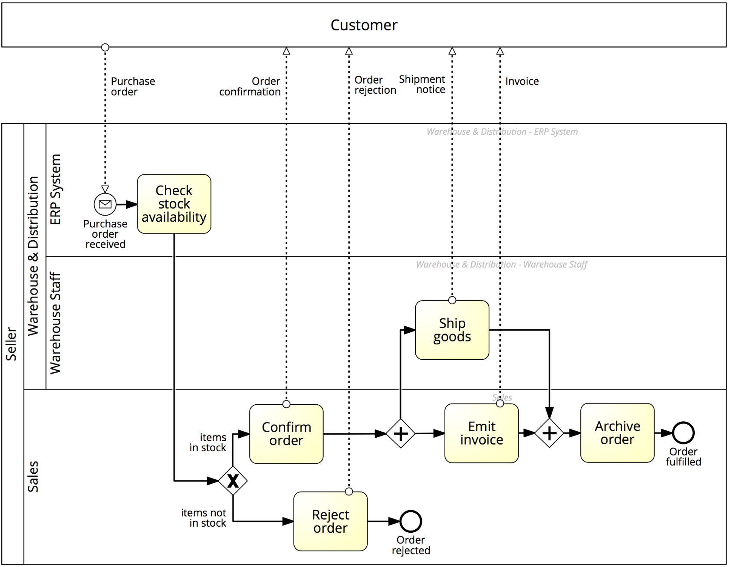


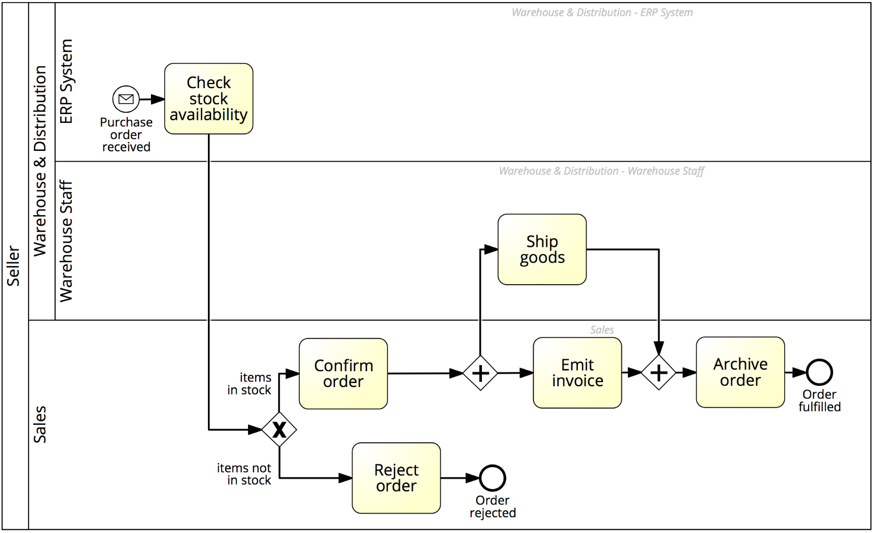
Order-to-cash process with a black-box customer pool
Notes:
Now we have all ingredients to capture our order to cash example

Slide 40
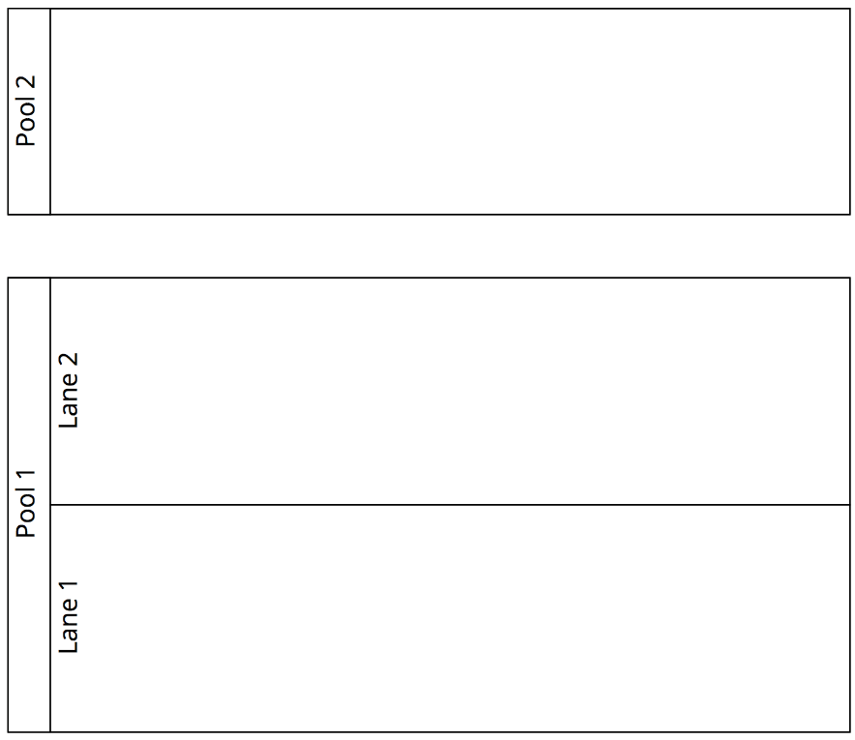
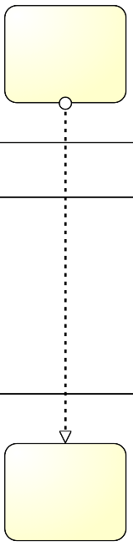

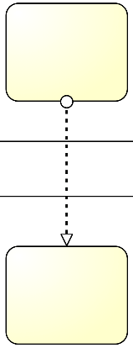


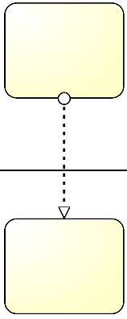
Pools, Lanes and Flows: syntactic rules
A Sequence Flow cannot cross the boundaries of a Pool (message flows can)
Both Sequence Flow and Message Flow can cross the boundaries of Lanes
A Message Flow cannot connect two flow elements within the same pool
Notes:
So to sum up,

Slide 41
One more guideline…
Start modeling with one single “white-box” pool
Initially, put the events and tasks in only one pool – the pool of the party who is running the process
Leave all other pools “black-boxed”
Once you have modeled this way, and once the process diagram inside the white-box pool is complete, you can model the details (events and tasks) in the other pools if that is useful.
In this course we will only model processes with one single white-box pool – all other pools are black-box

Slide 42
Process Modelling Viewpoints
Which?
Data Objects, Stores
Data / Materials
Notes:
The Functional perspective, indicates What tasks/function are happening in the process?
The Control-flow perspective, indicates when should an activity be performed, that is, in what order should activities and events occur?
The resource perspective (also called organisational perspective) indicates Who performs which activity?
Finally, the data perspective indicate which data are necessary to perform each activity and which data are produced by each activity in the process?

Slide 43
BPMN Information Artifacts
A Data Object captures an artifact required (input) or produced (output) by an activity.
Can be physical or electronic
A Data Store is a place containing data objects that must be persisted beyond the duration of a process instance.
It is used by an activity to store (as output) or retrieve (as input) data objects.
Notes:
Represent input and output of a process activity.
, e.g. a database for electronic artifacts or a filing cabinet for physical ones.

Slide 44
Model with information artifacts

Slide 45
Quick Note: BPMN Text Annotations
A Text Annotation is a mechanism to provide additional text information to the model reader
Doesn’t affect the flow of tokens through the process
Notes:
Sometimes we may need to provide additional information to the process model reader, for the sake of improving the understanding of the model. For example, in the order-to-cash process we may want to specify that activity “Ship goods” also includes the packaging of the products. Also, we may want to clarify what business rule is followed behind the choice of suppliers or the approval of an order. All this information is provided via text annotations which do not affect the flow of the process model.
Say that in a text annotation the connection, called association in BPMN, is undirected
A text annotation is depicted as an open-ended rectangle encapsulating the text of the annotation, and is linked to a process modeling element via a dotted line

